Slide 1
READ ME This template uses the font ‘Space Grotesk’ – be sure to download the font before making edits to the deck. Here’s the link to the ZIP file containing the font. If you cannot access the link above, you can download the font for free via Google Fonts.

Slide 2
Blazor Frontend

Slide 3
Blazor is…

Slide 4
ASP.NET Web development framework

Slide 5
ASP.NET Web development framework
Frontend app dev with .NET

Slide 6
ASP.NET Web development framework
Frontend app dev with .NET
Component-based framework

Slide 7
Different types of Blazor

Slide 8
Blazor Server

Slide 9
Blazor Server
Blazor WebAssembly

Slide 10
Blazor Server
Blazor WebAssembly
Blazor Hybrid

Slide 11
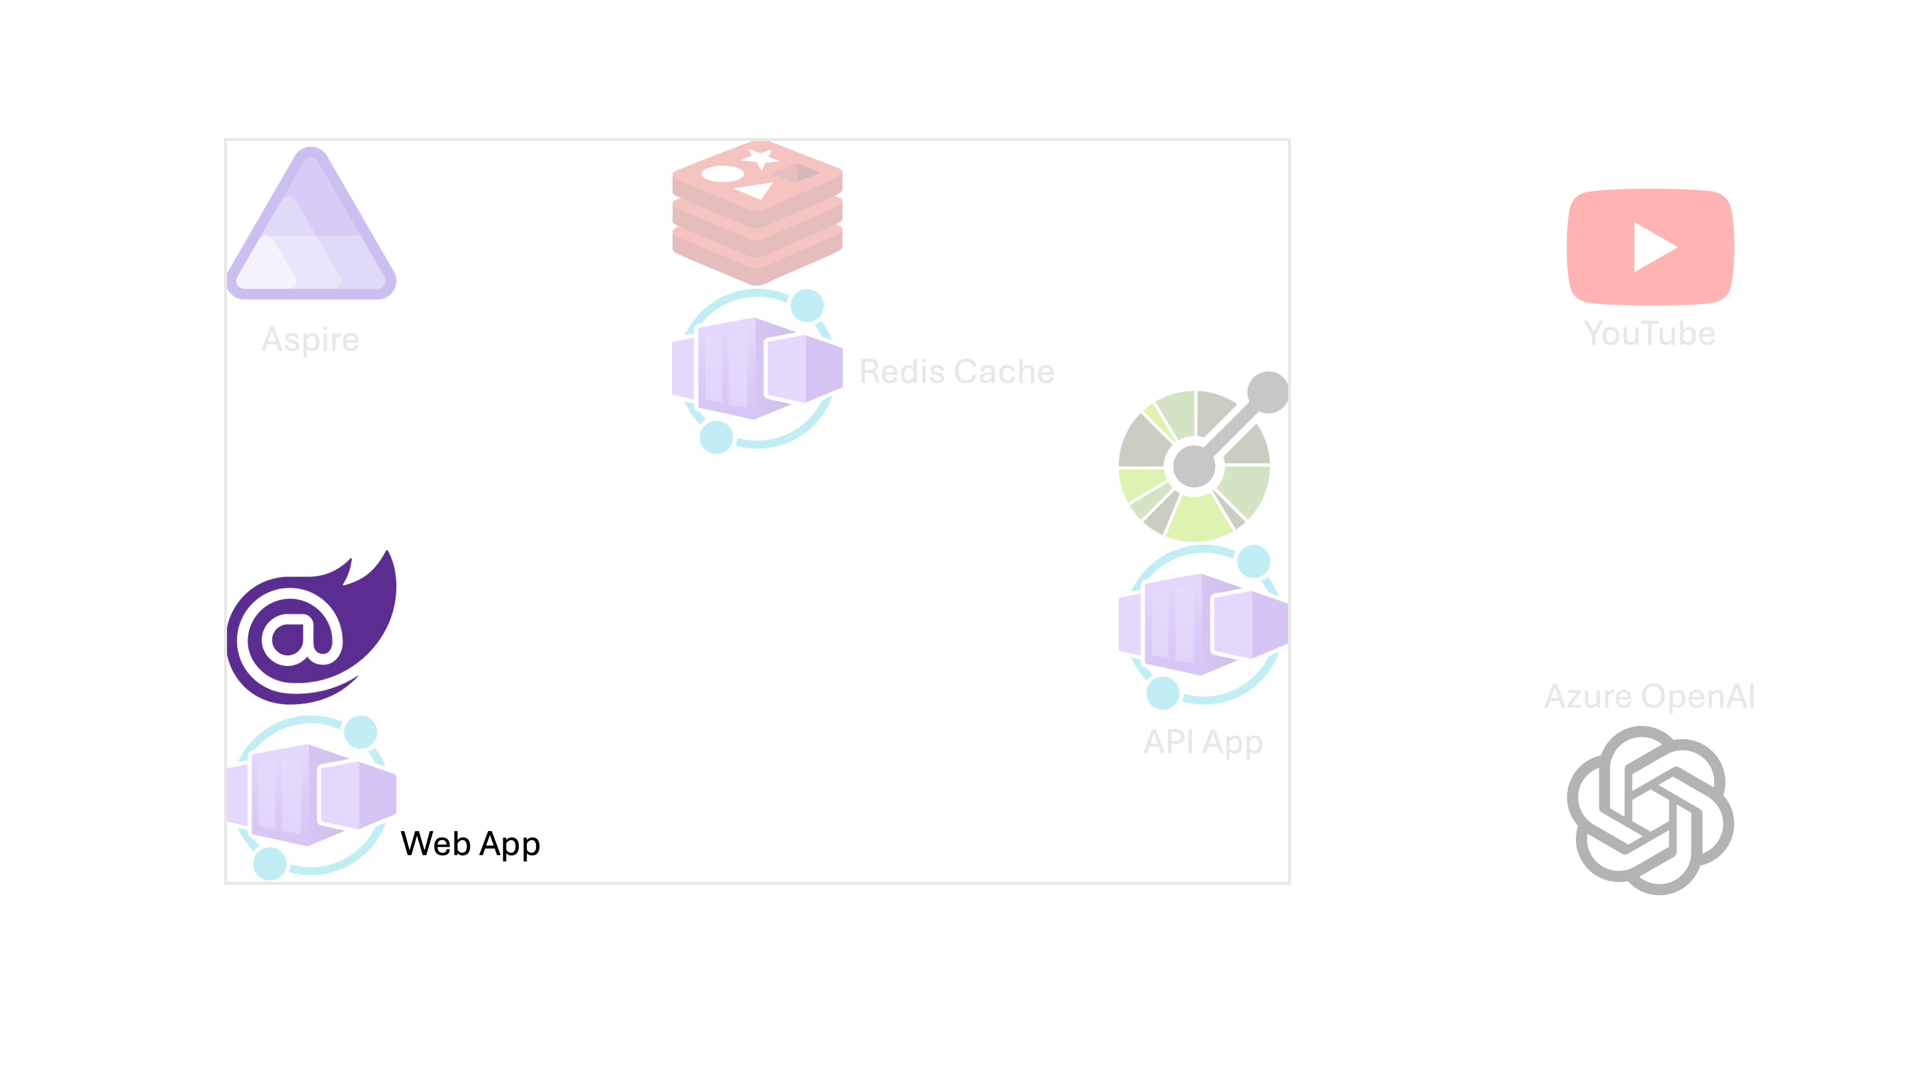

Slide 12
Let’s get started!
https://aka.ms/aspireinadaykr

